Slide 1


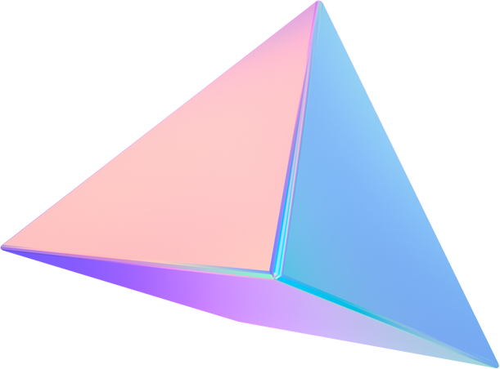


Campus Lighting Monitoring using Digital Twin Technology

Slide 2
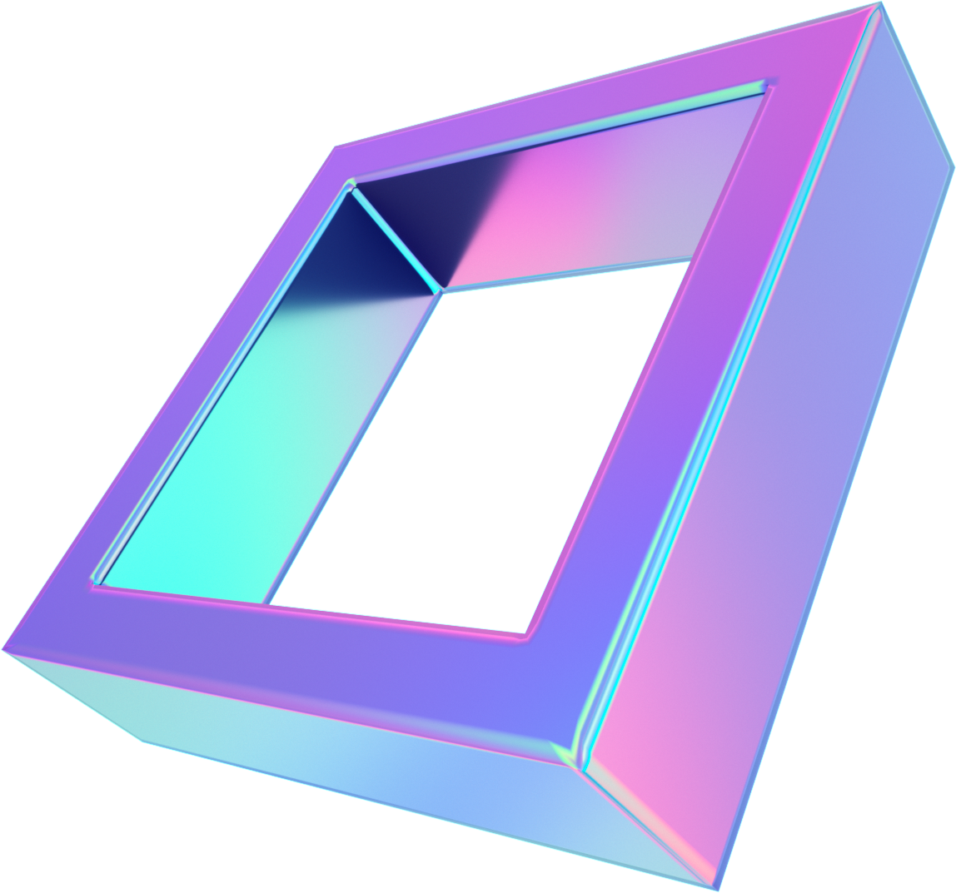
Objectives
Primary objective is to save power consumption within an enterprise by using Digital Twin Technology.
3D models of the buildings of interest within the campus are developed in Unreal using LIDAR sensors and Particle System.
View the buildings and turn-off or turn-on the lights in Virtual world, IOT will turn-off or turn-on the physical lights.
It will save electricity with almost zero manual intervention.
Technologies
IOT programming, Unreal Engine 4.27,
Amazon Web Services

Slide 3
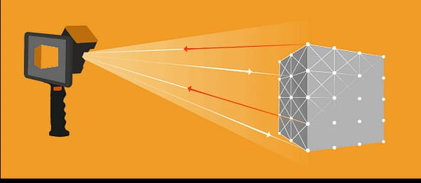
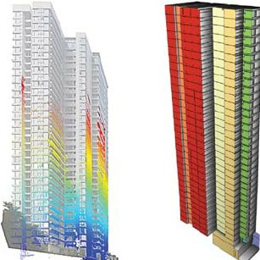
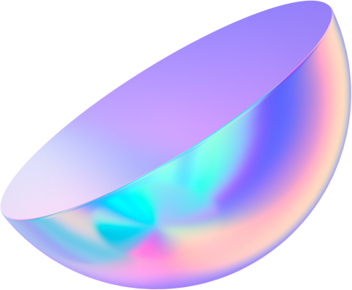
Digital Twin
A digital twin is an integrated multi-physics, multi-scale, probabilistic simulation of a complex product and uses the best available physical models, sensor updates, etc., to mirror the life of its corresponding twin.
Light Detection and Ranging (LiDAR)

Slide 4
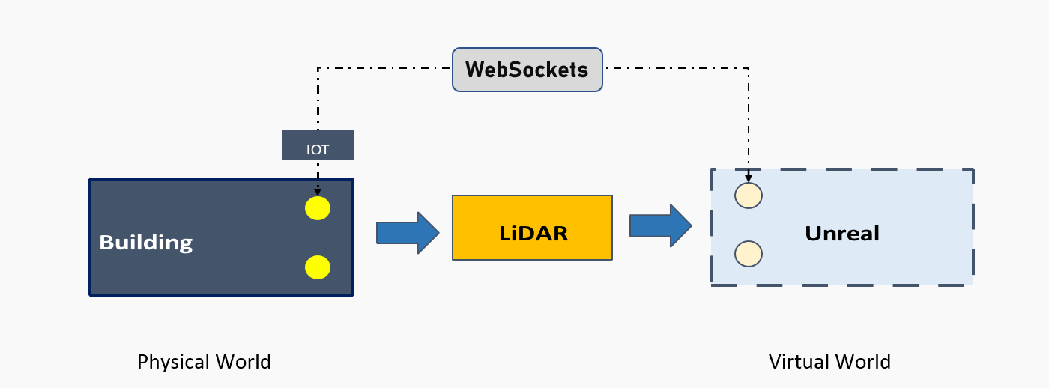
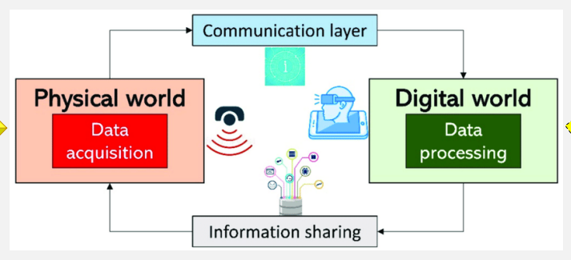
Simulation

Slide 5
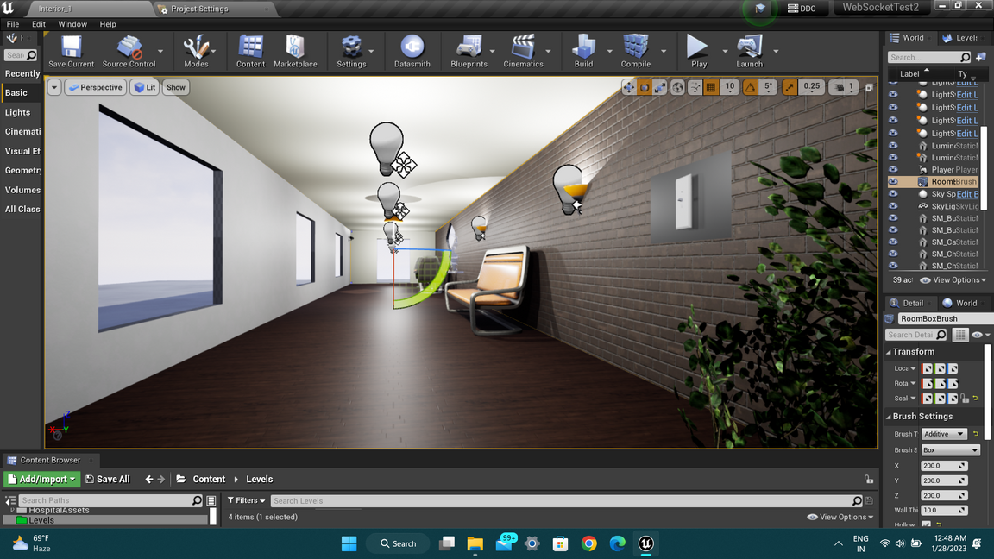
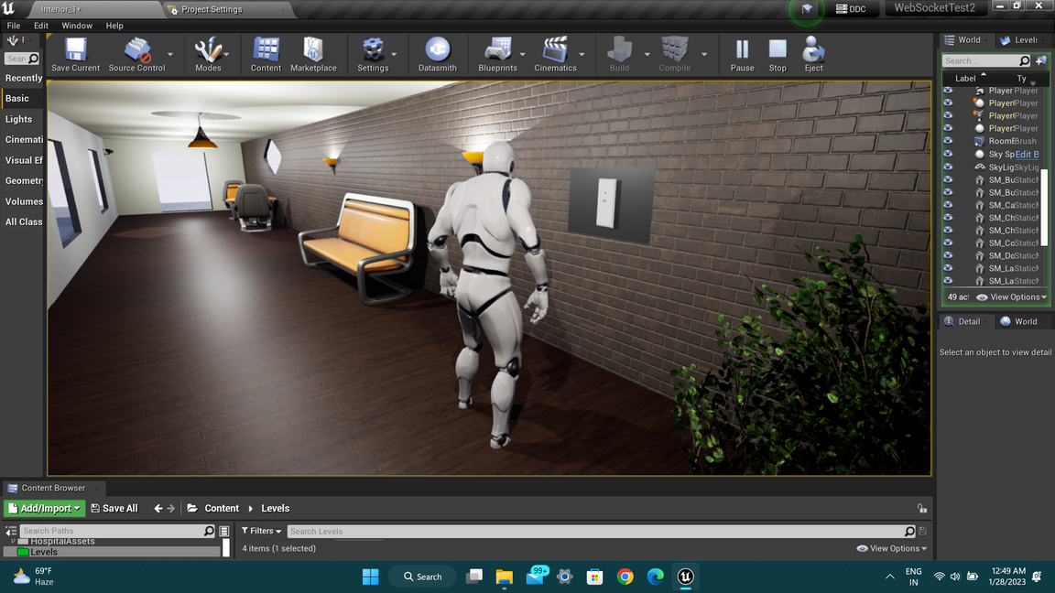
Virtual model (Unreal)
Creating a Virtual world by taking the proper data from the LiDAR
Enhancing the Environment in Unreal
Lighting is made similar to the Real World and can be controlled using Unreal
Any changes ( turning lights on and off ) made to lights will reflect in both the worlds

Slide 6
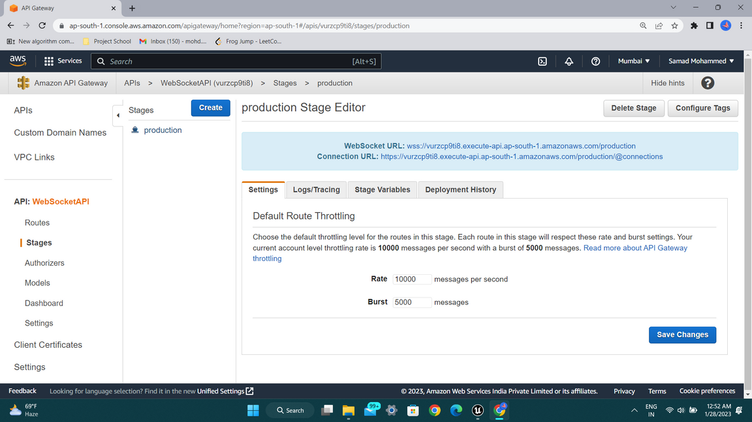
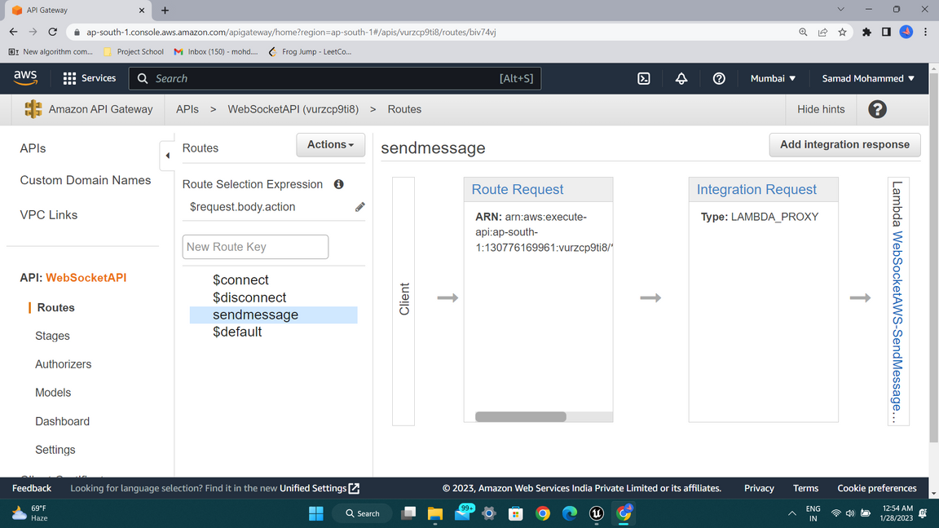
WebSocket URL is used to connect the Unreal Engine and IOT device for Bi-communication.
API Routes with Lambda functions that handles respective user requests.

Slide 7
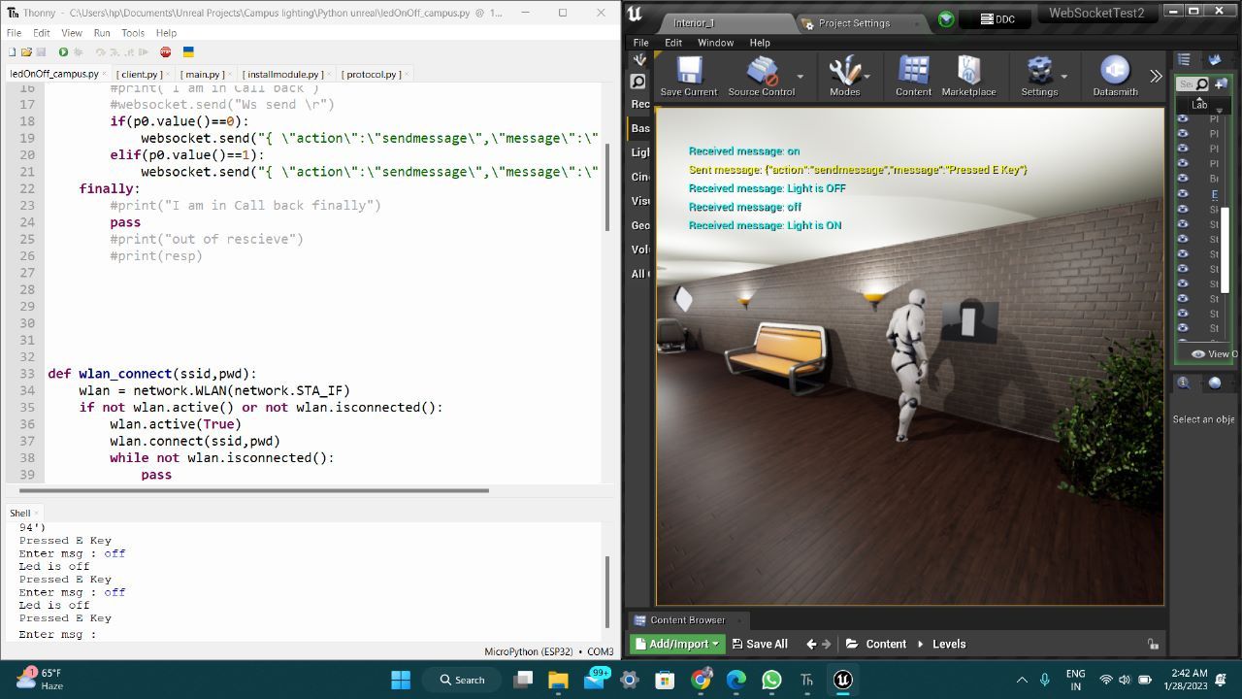
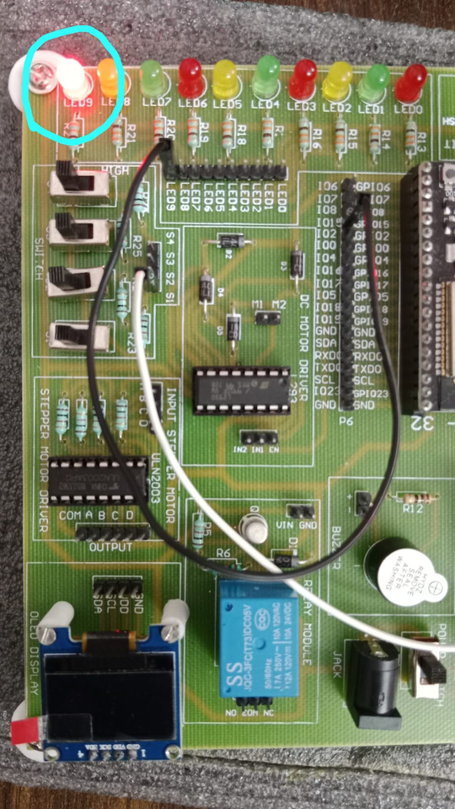
Evaluation and Decision making
Using Thonny Interpreter to control IOT device
Lights are ON in both the worlds

Slide 8
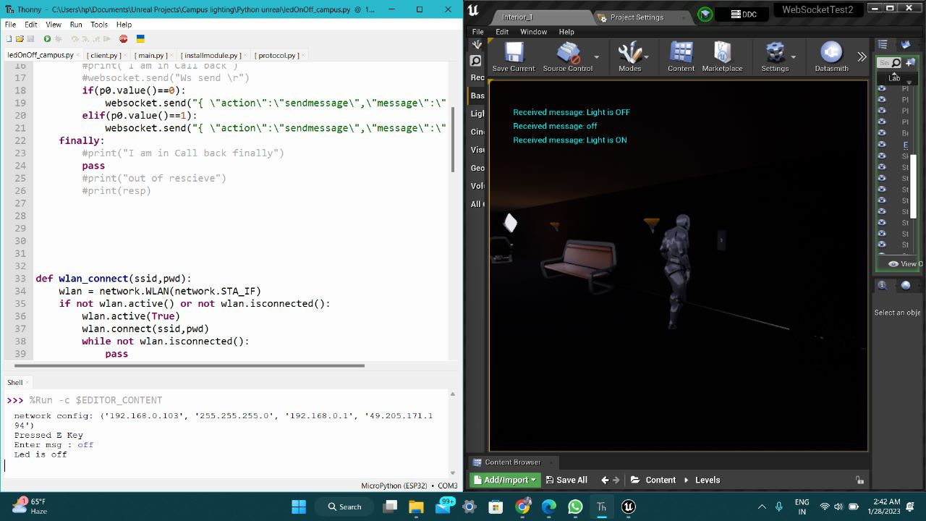
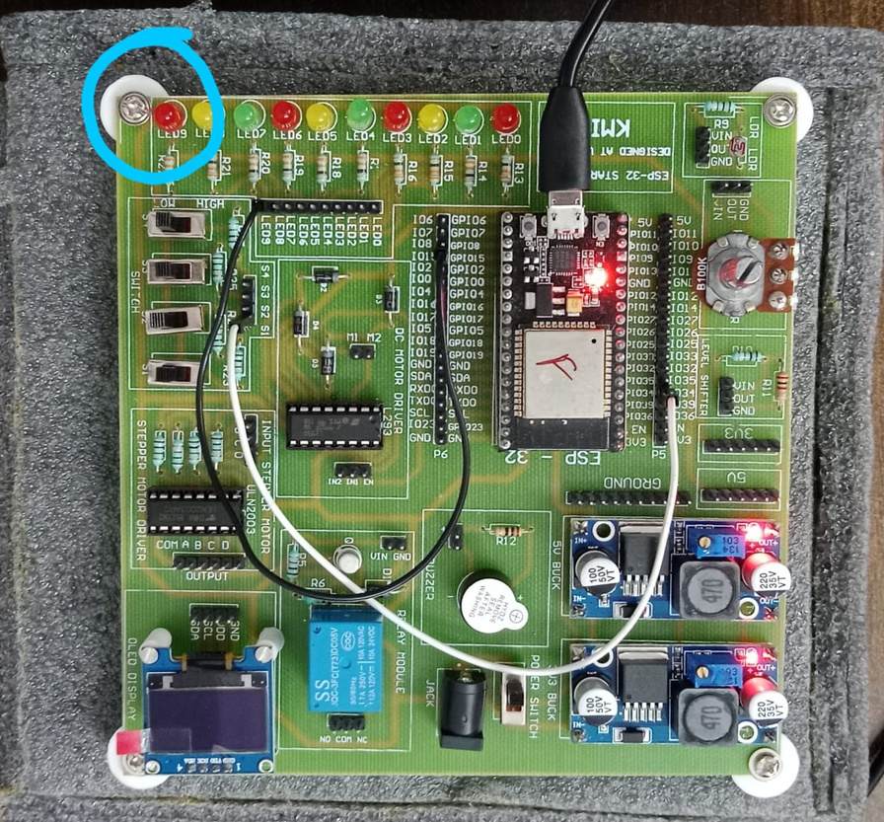
Evaluation and Decision making
Input ( off ) is given in Thonny, which turned off light in both the worlds

Slide 9
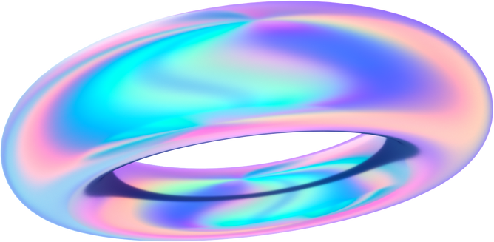
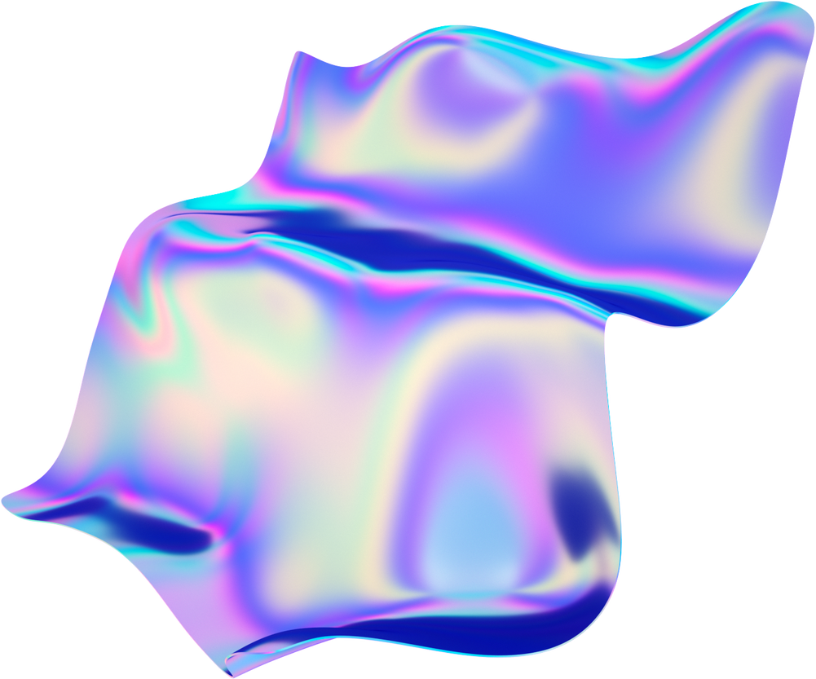
Benefits
Ease of Installation and Integration
Reduced Costs,
saves Electricity
Smarter Energy
Improved safety with Smart Campus Lighting

Slide 10
Thank You
Mohammed Abdul Samad
20BD1A0554
mohd.ssamad01@gmail.com

